Slide 1

CORE TOPICS

Slide 2





ACTIVITIES
INTENT
EVENT MENU

Slide 3
ACTIVITIES
The Activity class is a important component of an Android app
Unlike programming paradigms in which apps are launched with a main() method.
Activity Lifecycle: Activity is one of the building blocks of Android OS. In simple words Activity is a screen that user interact with. Every Activity in android has lifecycle like created, started, resumed, paused, stopped or destroyed.

Slide 4
ACTIVITIES
Most apps contain multiple screens, which means they include multiple activities. Typically, one activity in an app is defaul as the main activity, which is the first screen to appear when the user launches the app.
Each activity can then start another activity in order to perform different actions.
For example, the main activity in a simple e-mail app can provide the screen that shows an e-mail inbox. Therefore, the main activity can launch (run) other activities that provide screens for tasks like writing e-mails and opening individual e-mails.

Slide 5
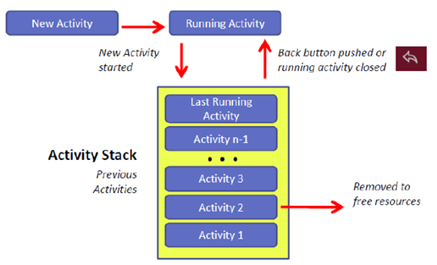
ACTIVITIES STACK
Similar to other programming languages, Activity Stack works under LIFO mechanism (LAST IN FIRST OUT)

Slide 6
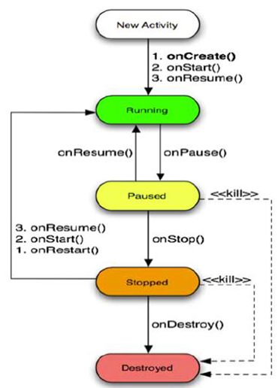
ACTIVITIES LIFECYCLE
1- Running (đang kích hoạt)
2- Paused (tạm dừng)
3- Stopped (dừng – không phải Destroyed)

Slide 7
States
1- Running (đang kích hoạt):
When the screen is Foreground (Activity is on the first of the application and allows the user to interact)
2- Paused (tạm dừng) :
Activity lost focus but still can see this Activity (For example, you open a new Activity as a Dialog). In this case it is still possible that the system automatically "KILL" in the situation of too little memory.

Slide 8
States
3- Stopped (dừng – không phải Destroyed): The activity loses focus and cannot be seen (for example, when you open a new activity on a full screen, for example). In this case, it can be "dealt" in any situation (tình huống) .
*** Thus, both Paused or Stopped are likely to be destroyed (destroyed) when the memory needed for other priority.

Slide 9
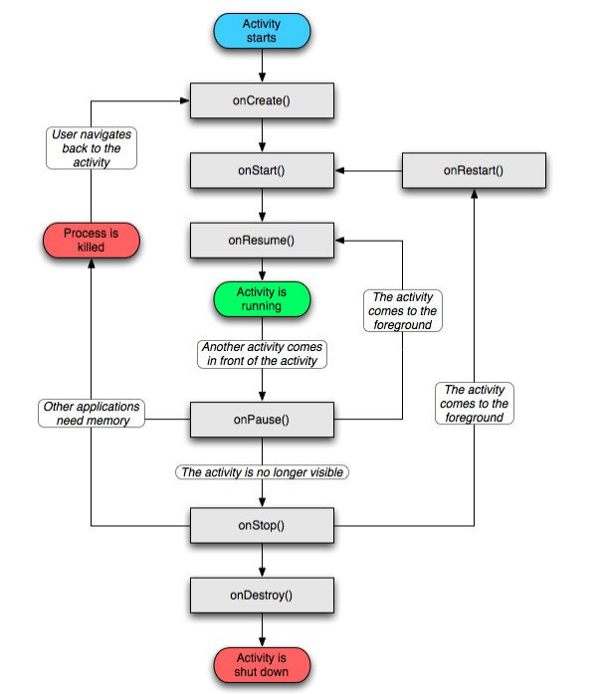
ACTIVITIES LIFECYCLE

Slide 10
OnCreate()
You must implement this callback, which start when the system creates your activity.
Your implementation should create the essential components of your activity.
Most importantly, this is where you must call setContentView() to define the layout for the activity's user interface.
When onCreate() finishes the next callback is always onStart().

Slide 11
Attention
Open a new Activity to obscure (che khuất) all the old Activity (not see the old Activity): an onPause event then onStop for the old Activity
b) Open the new Activity to partially obscure (che khuất 1 phần) the old Activity (still see the old Activity): There is an onPause event for the old Activity.
When returning to the old Activity, after completing the necessary functions, it must definitely call the onResume function to restore the application state.
- So we usually save the state of the application in the onPause event and re-read the application state in the onResume event.

Slide 12
ACTIVITIES
INTENT
EVENT MENU

Slide 13
INTENT
Intent is a messaging object you can use to request an action from another app component.
Although intents facilitate communication between components in several ways, there are three fundamental use cases
Starting an activity
Starting a service
Delivering a broadcast

Slide 14
INTENT
Starting an activity
You can start a new instance of an Activity by passing an Intent to startActivity()
Starting a service
A Service is a component that performs operations in the background without a user interface. With Android 5.0 (API level 21) and later, you can start a service with JobScheduler

Slide 15
INTENT
Delivering a broadcast
A broadcast is a message that any app can receive.
The system delivers various broadcasts for system events, such as when the system boots up or the device starts charging.
You can deliver a broadcast to other apps by passing an Intent to sendBroadcast() or sendOrderedBroadcast()

Slide 16
INTENT TYPES
Explicit Intent:
Explicit Intents are used to connect the application localy.
In Explicit we use the name of component which will be affected by Intent.
For Example: If we know class name then we can navigate the app from One Activity to another activity using Intent.
In the similar way we can start a service to download a file in background process.

Slide 17
INTENT TYPES
Explicit Intent:
Explicit Intent work internally within an application to perform navigation and data transfer. The below given code snippet will help you understand the concept of Explicit Intents
Intent intent = new Intent(getApplicationContext(), SecondActivity.class);
startActivity(intent);

Slide 18
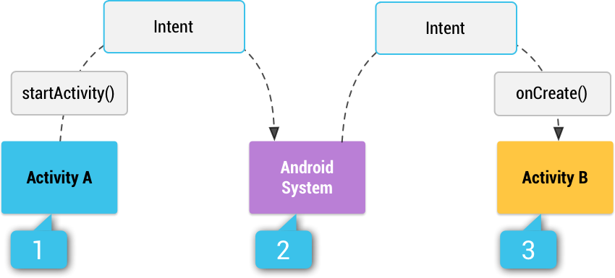
INTENT

Slide 19
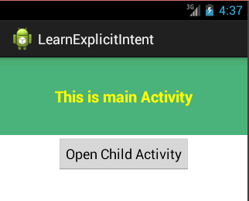
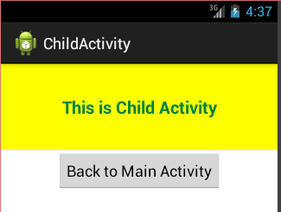
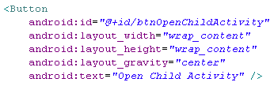
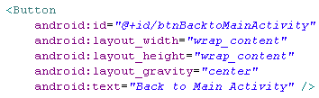
INTENT TYPES
btnOpenChildActivity
btnBacktoMainActivity

Slide 20
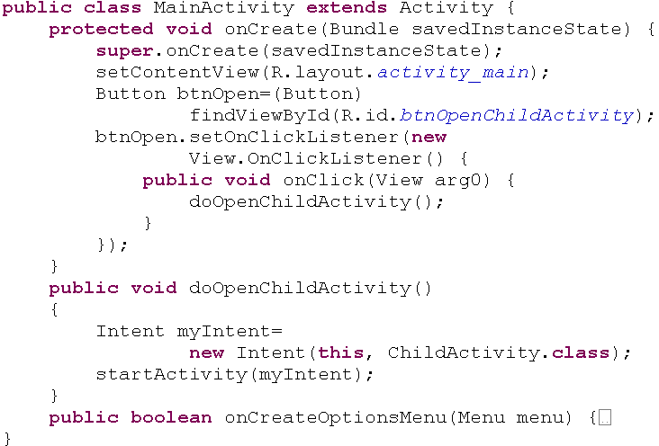
INTENT TYPES

Slide 21
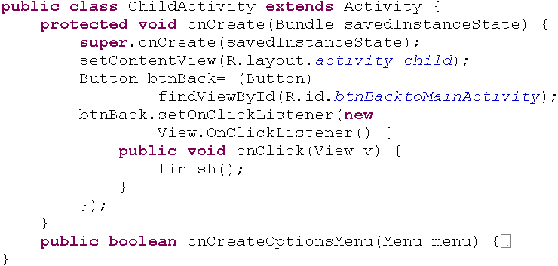
INTENT TYPES

Slide 22

INTENT TYPES
Bundle
An activity usually presents a single visual user interface from which a number of actions could be performed.
Moving from one activity to another is accomplished by having the current activity start the next one through so called intents
Activity 2
Intent
{action + data}
Activity 1
startActivity
(Activity 2)
Package from activity 1

Slide 23
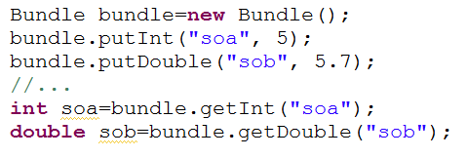
INTENT TYPES
Bundle
The Android Bundle container is a simple mechanism used to pass data between activities.
A Bundle is a type‐safe collection of <name, value> pairs.
There is a set of putXXX and getXXX methods to store and retrieve (single and array) values of primitive data types from/to the bundles. For example
Put
get

Slide 24
ACTIVITIES
INTENT
EVENT MENU

Slide 25
EVENT
Event Listeners - An Even Listener is an Interface in the View class that contains a callback method. These methods will be able to be called by the Android Framework when the registered listener is triggered by user interaction with the item in the UI interface.
Event Handlers - When an Event happens, and we have registered an Event Listener for the event, the Event Listener calls the Event Handler, the method that actually handles the event.

Slide 26
EVENT
Event Handler | Event Listener & Miêu tả
onClick() | OnClickListener() Called when the user either clicks or touches or focuses on any widget such as button, text, image ... You will use the event handler, onClick (), to handle the event like that.
onLongClick() | OnLongClickListener() Called when the user either clicks or touches any widget such as button, text, image ... in a few seconds. You will use the event handler onLongClick () to handle the event like that
onMenuItemClick() | OnMenuItemClickListener() Called when the user selects an item in the menu. You will use the event handler onMenuItemClick () to handle the event like that

Slide 27
ACTIVITIES
INTENT
EVENT MENU

Slide 28
MENU
Menus are a common user interface component in many types of applications.
To provide a familiar and consistent user experience, you should use the Menu APIs to present user actions and other options in your activities.

Slide 29
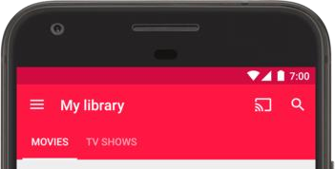
OPTION MENU
the primary collection of menu items for an activity. It's where you should place actions that have a global impact on the app, such as "Search," "Compose email," and "Settings."

Slide 30
CONTEXT MENU
A context menu is a floating menu that appears when the user performs a long-click on an element. It provides actions that affect the selected content or context frame.
The contextual action mode displays action items that affect the selected content in a bar at the top of the screen and allows the user to select multiple items.

Slide 31
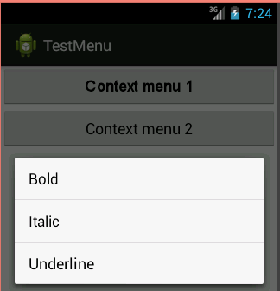
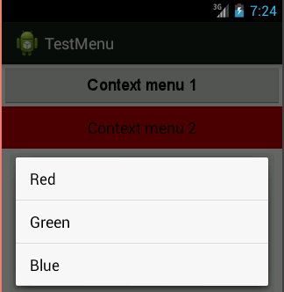
CONTEXT MENU
Long press to show context menu

Slide 32
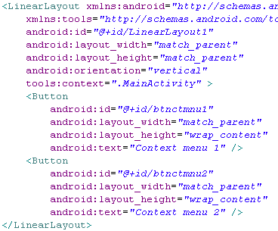
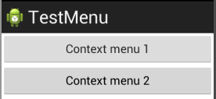
CONTEXT MENU

Slide 33
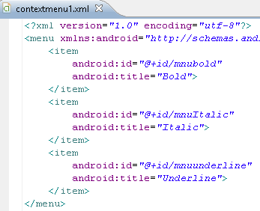
CONTEXT MENU

Slide 34
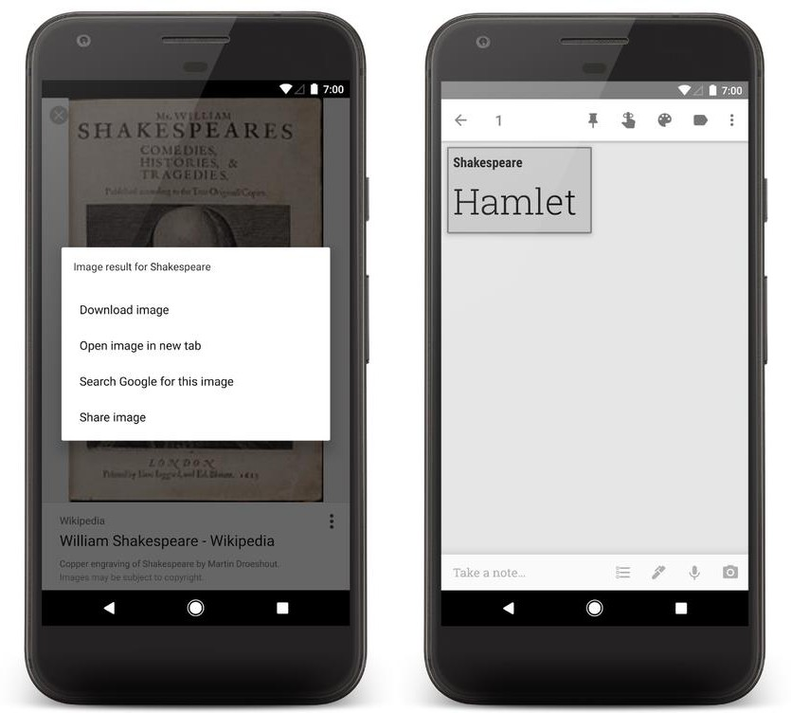
CONTEXT MENU

Slide 35
CONTEXT MENU
•Option and Context Menus may include:
–1.Text
–2. Icons
–3. Radio Buttons
–4. Check Boxes
–5. Sub-menus
–6. Short-cut keys

Slide 36
QUESTION
&
THANK YOU FOR YOUR ATTENTION

